Slide 1
Vehicle Detection in Autonomous Vehicles

Slide 2
Group Members
Muhammad Hamza SP20-BCS-082
Uzair Altaf SP20-BCS-048
Haseeb ur Rehman SP20-BCS-127

Slide 3
Problem
Problem & Challenge - Summary
We present a scheme of how we can help drivers and provide a way to reduce car accidents
Our project mainly is about object detection and distance estimation of vehicle

Slide 4
Phase A: Specifications & Setup
Our Proposed Solution - Summary
We solve this problem by estimating distance for detected objects in the roads using YoloV3.
We will use distance of detected objects to provide some information to the driver which in turn will reduce car accidents.

Slide 5
What is Yolo
YOLO, stands for 'You only look once, is an object detection algorithm that divides images into a grid system. Each cell in the grid is responsible for detecting objects within itself.

Slide 6
Why Yolo?
In addition to increased accuracy in predictions and a better Intersection over Union in bounding boxes(compared to real-time object detectors), YOLO has the inherent advantage of speed.
YOLO is a much faster algorithm compare to other real time object detectors like rcnn ,fast rcnn ,faster rcnn etc .YOLO runs at as high as 45 FPS.

Slide 7
How does YOLO works?
The YOLO algorithm works by dividing the image into N grids, each having an equal dimensional region of SxS. Each of these N grids is responsible for the detection and localization of the object it contains.

Slide 8
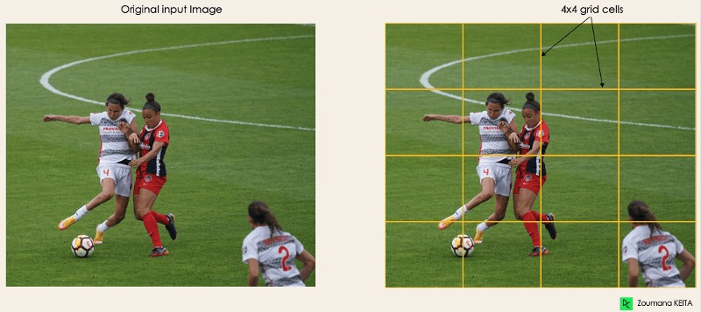

Slide 9
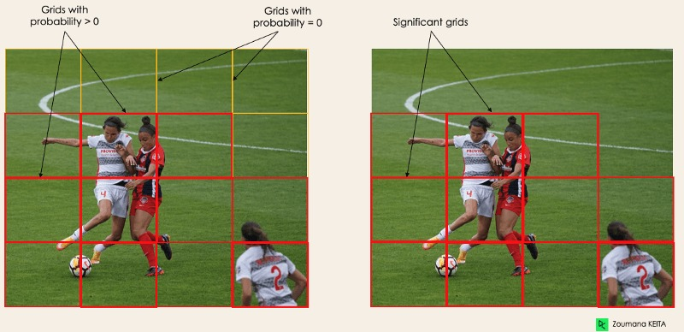

Slide 10
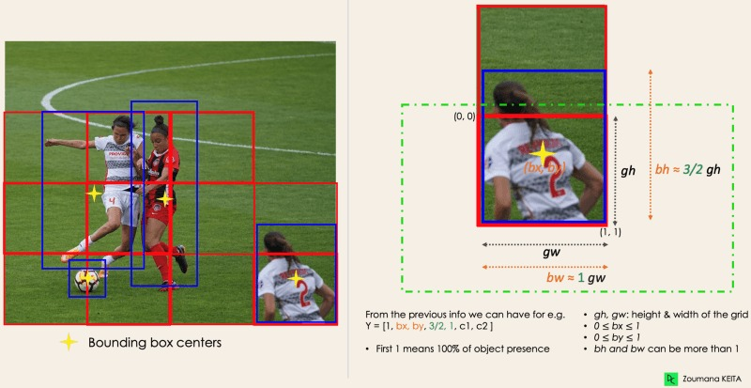

Slide 11
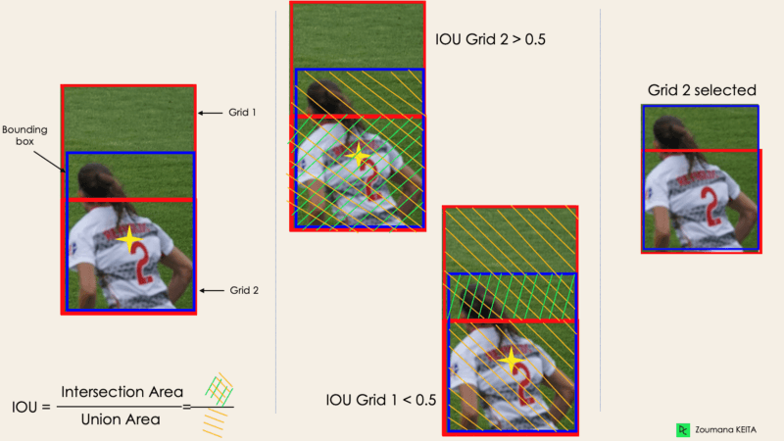

Slide 12
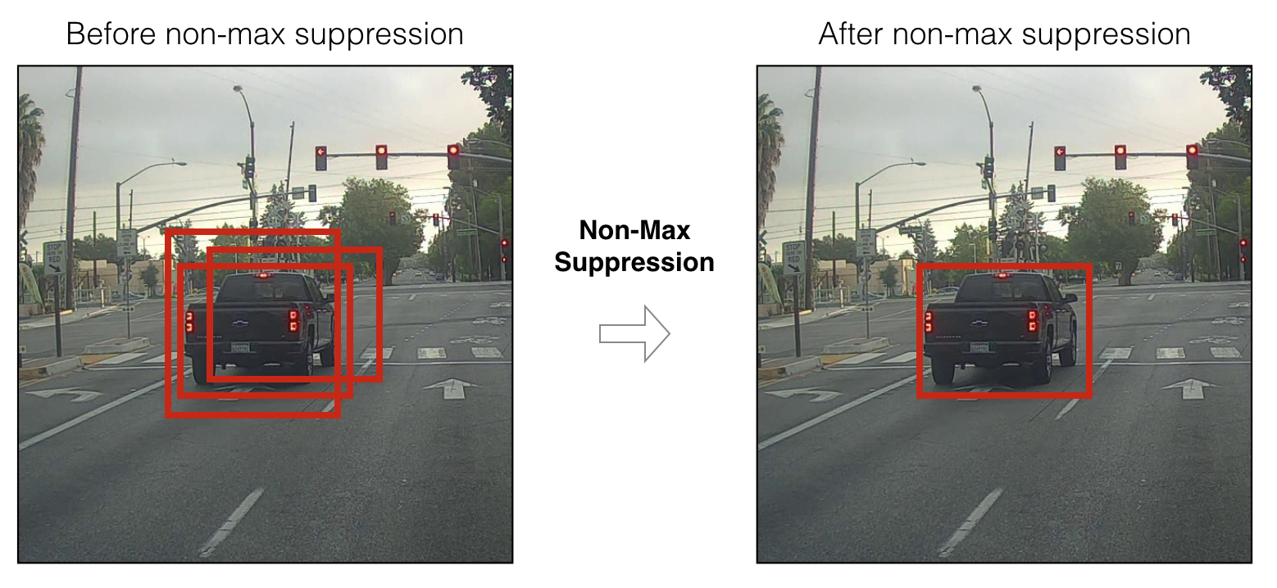
Non-max Suppression

Slide 13
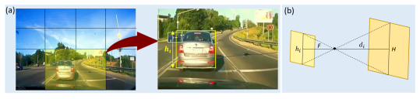
Distance Calculation

Slide 14
Distance Calculation Cont..
Distance to the nearest vehicle by using same triangle principles
di = HF/hi = 250H/hi

Slide 15
For further reading
https://pylessons.com/YOLOv3-introduction
https://towardsdatascience.com/non-maximum-suppression-nms-93ce178e177c
https://pjreddie.com/darknet/yolo/
https://www.datacamp.com/blog/yolo-object-detection-explained

